Slide 1

CarbonEase a An app that helps calculate and suggests ways to reduce carbon footprint
CarbonEase
TEAM INNOVATORS

Slide 2

Problem Statement
Design an app that helps users adopt more sustainable living practices, such as reducing energy consumption, recycling or tracking carbon footprints.
Use design thinking to determine which features will be the most helpful and motivating for users.

Slide 3
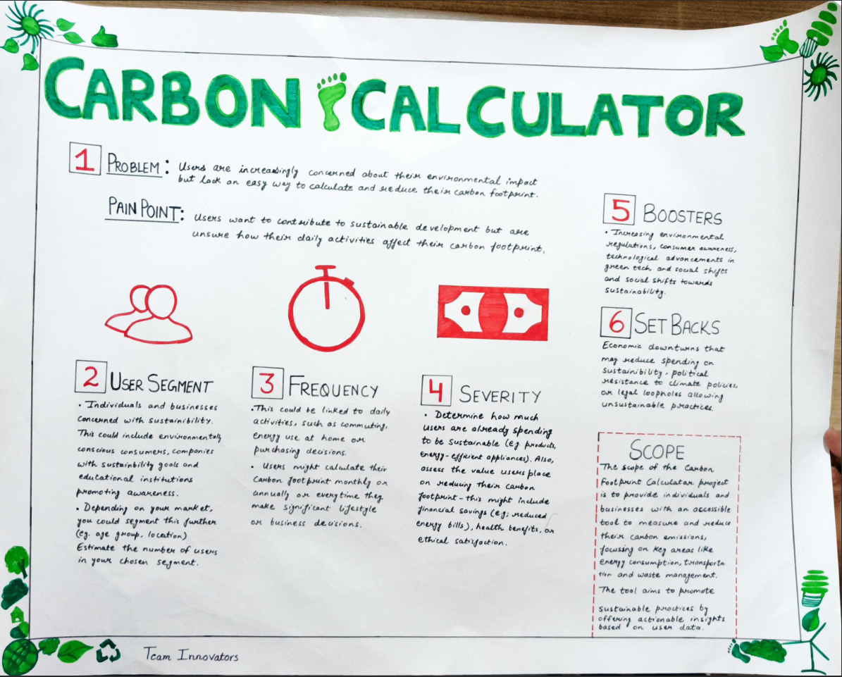
Problem Sizing

Slide 4
Problem Sizing Canvas is a tool used in the design thinking process to clearly define and assess the size, scope, and impact of a problem before moving forward with potential solutions. It helps teams to understand the problem in depth, ensuring that they address the right issues with an appropriate scope.
Once a problem’s size has been validated, you can start thinking of solutions.
Here’s a brief explanation of the canvas:
Problem & Pain Point: Users struggle with understanding and reducing their carbon footprint, seeking a way to track and act on their environmental impact.
User Segment: Targeted at environmentally conscious individuals and businesses, adaptable for different user groups.
Frequency: Tracks daily, monthly, or yearly activities like commuting, energy consumption, and purchases.

Slide 5
Severity: This part assesses how much users are already invested in sustainability and how much a tool could help them reduce their footprint, like through reduced energy bills or ethical decision-making.
Boosters & Setbacks: It acknowledges factors that can either encourage or hinder users, such as increased environmental awareness (boosters) or economic downturns affecting spending on green initiatives (setbacks).
Scope: The scope outlines the capabilities of the carbon footprint calculator, focusing on providing user insights, suggesting reductions, and targeting specific areas like waste management and energy use for a broader impact on sustainability.

Slide 6
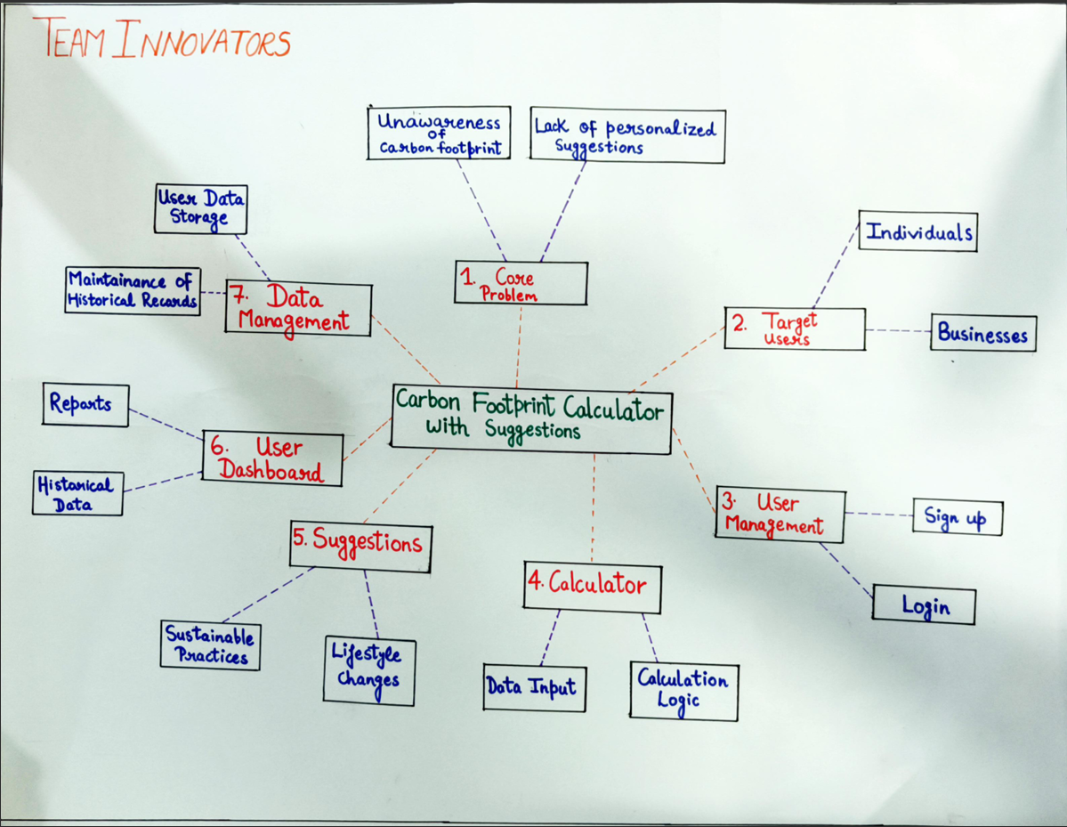
Mind Map

Slide 7
Mind mapping is a visual thinking tool that helps organize information, ideas, and concepts in a structured way. It typically involves creating a diagram that starts with a central idea or topic, branching out into related subtopics and ideas
CarbonEase
Target Audience
Individual
Businesses
User Needs
Lack Of Awareness
User Pain Points
Difficulty in Tracking
Current Market
Trends in Sustainability
Challenges
Potential Opportunities
Core Problem Analysis
Problem Focus Area
Impact of the Problem

Slide 8
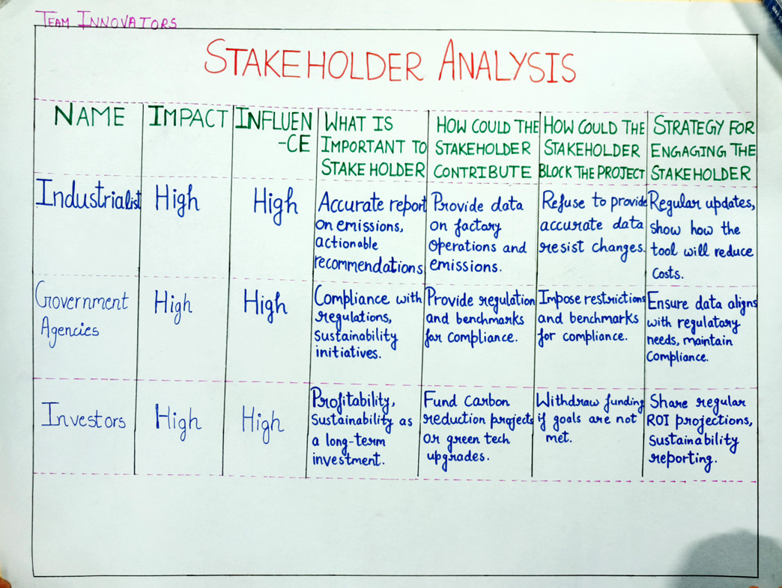
Stakeholder Analysis

Slide 9
Stakeholder is an individual or a group of individuals with an interest, often financial, in the success of a business.
Industrialists
They value accurate emissions data and can provide important operational info but may resist changes. Keeping them engaged requires showing cost-saving benefits.
Government Agencies
They emphasize regulatory compliance and offer guidelines but may impose restrictions. Aligning the project with legal standards is key to maintaining their support.
Investors
They prioritize profitability and long-term sustainability, offering funding but might withdraw if goals aren’t met. Regular updates on financial returns and project impact keep them engaged.

Slide 10
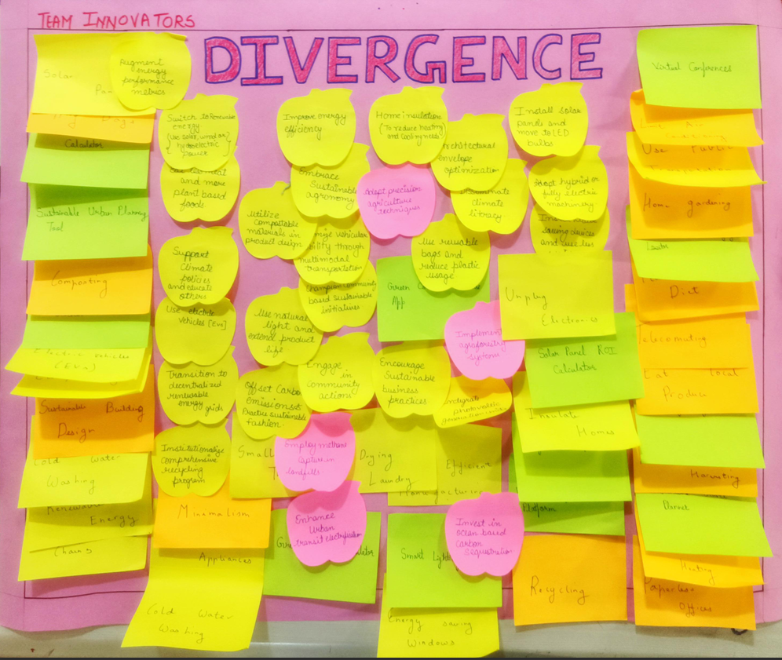
Brainstorming

Slide 11
Brainstorming is a collaborative technique where a group generates ideas to solve a specific problem. It allows for open sharing of thoughts, leading to creative solutions.
Benefits of Brainstorming
Diverse Perspectives: Brings together different viewpoints, helping to explore a wide range of solutions like renewable energy use, home insulation, and sustainable practices.
Creativity Boost: Encourages thinking outside the box, leading to innovative ideas like urban gardening and smart energy solutions.
Building on Ideas: Allows participants to refine and improve ideas, making simple concepts more effective, such as evolving energy-saving methods into comprehensive carbon reduction strategies.

Slide 12
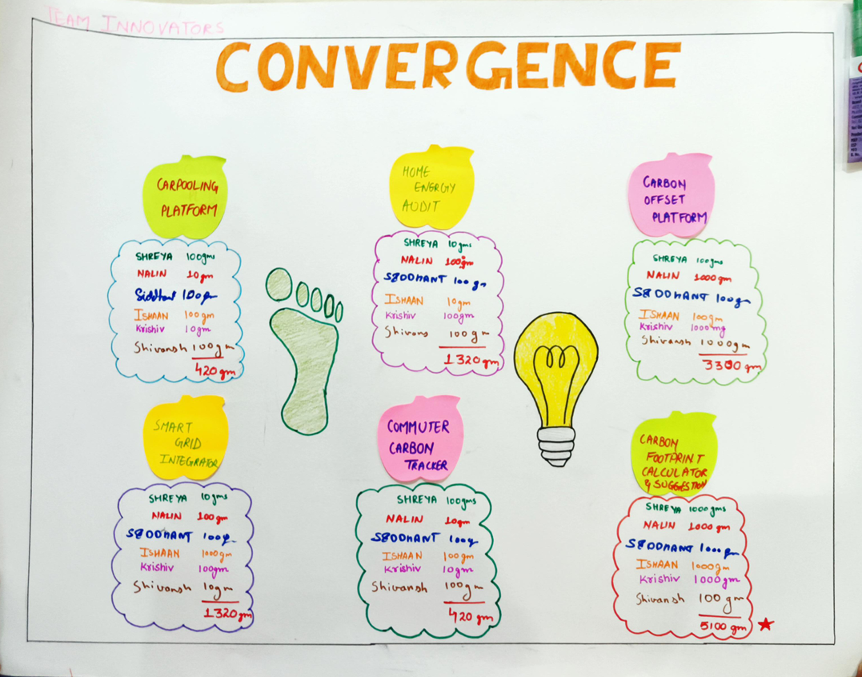
Convergence

Slide 13
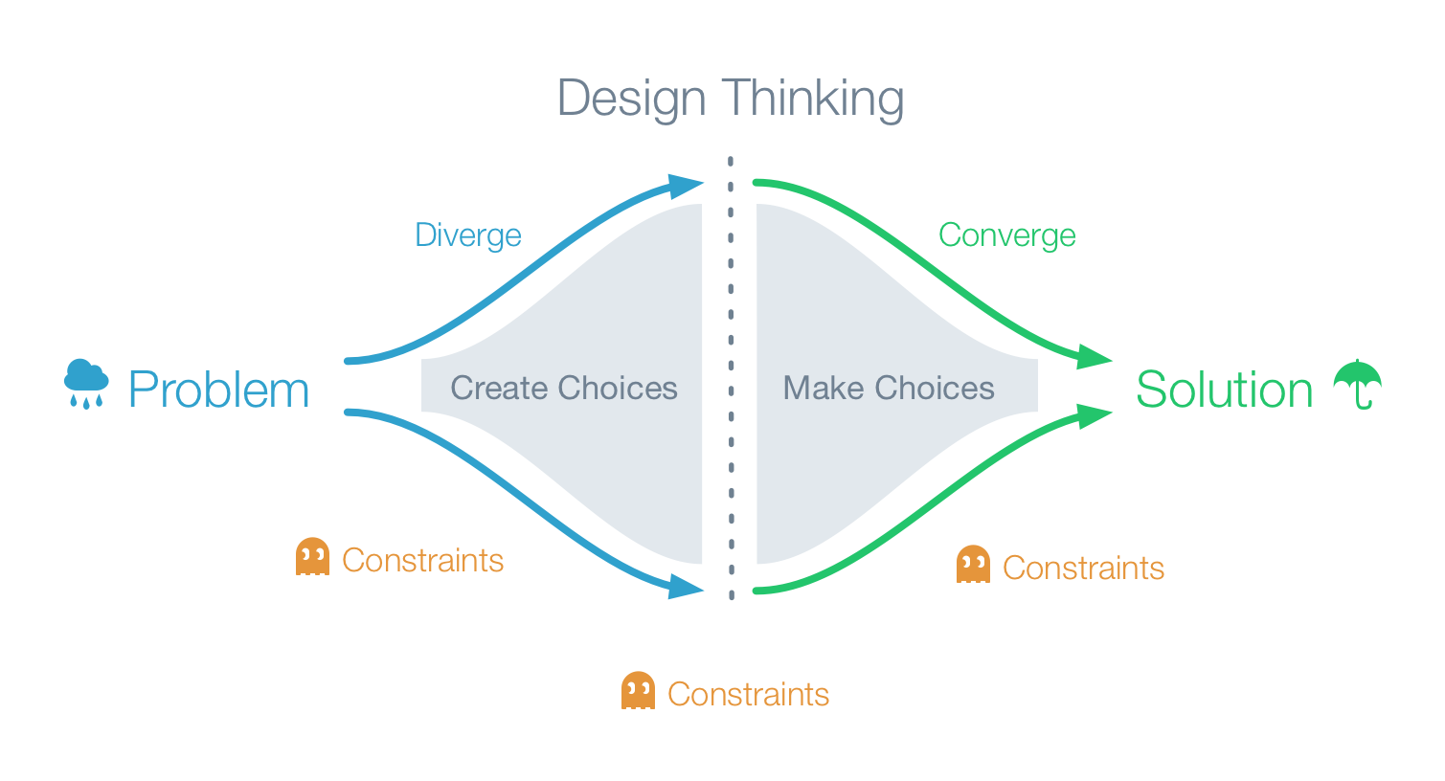
Convergent thinking refers to the process of selecting, evaluating, and refining the most promising ideas from the divergent phase. It involves narrowing down and refining possibilities by selecting the best ideas and combining them to create a coherent and effective solution.

Slide 14
6 Ideas rated with 10gm,100gm,1000gm Technique
CARPOOLING PLATFORM
Shreya | 100gm
Nalin | 10gm
Siddhant | 100gm
Ishaan | 100gm
Krishiv | 10gm
Shivansh | 100gm
TOTAL | 420gm
HOME ENERGY AUDIT
Shreya | 10gm
Nalin | 1000gm
Siddhant | 100gm
Ishaan | 10gm
Krishiv | 100gm
Shivansh | 100gm
TOTAL | 1320gm
CARBON OFFSET SYSTEM
Shreya | 100gm
Nalin | 1000gm
Siddhant | 100gm
Ishaan | 100gm
Krishiv | 1000gm
Shivansh | 1000gm
TOTAL | 3300gm
SMART GRID SYSTEM
Shreya | 10gm
Nalin | 100gm
Siddhant | 100gm
Ishaan | 1000gm
Krishiv | 100gm
Shivansh | 10gm
TOTAL | 1320gm
COMMUTER CARBON TRACKER
Shreya | 100gm
Nalin | 10gm
Siddhant | 100gm
Ishaan | 100gm
Krishiv | 10gm
Shivansh | 100gm
TOTAL | 420gm
CARBON FOOTPRINT CALCULATOR
Shreya | 1000gm
Nalin | 1000gm
Siddhant | 1000gm
Ishaan | 1000gm
Krishiv | 1000gm
Shivansh | 100gm
TOTAL | 5100gm

Slide 15
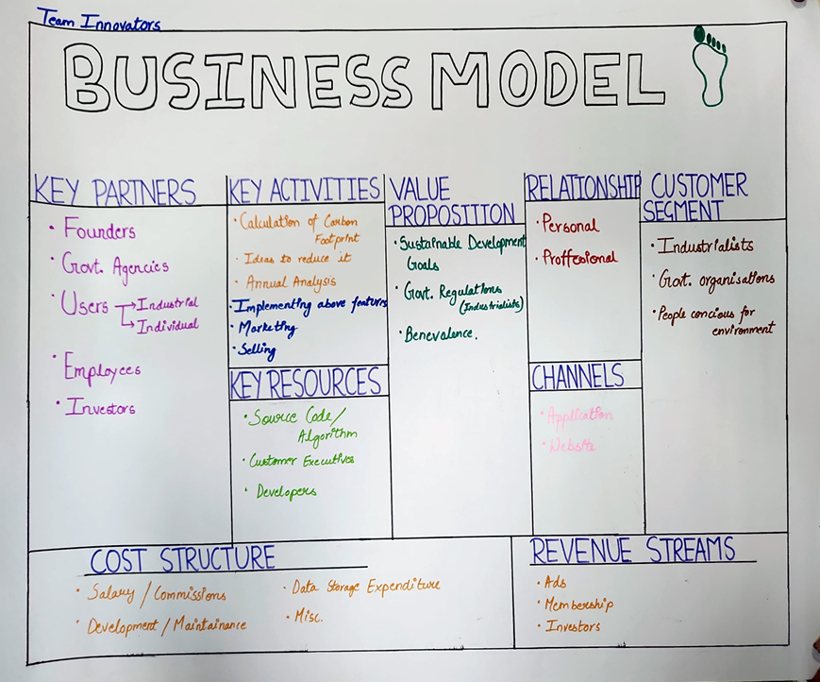
Business Model

Slide 16
Business Model Canvas is a strategic management template used for developing new business models and documenting existing ones.
It offers a visual chart with elements describing a firm's or product’s value proposition infrastructure, customers, and finances, assisting businesses to align their activities by illustrating potential trade-offs.
Key Partners - The people who will help you fulfill the key activities, using the key resources.
Founders
Government Agencies
Industrial Users
Individual Users
Employees
Investors

Slide 17
Key Partners - The people who will help you fulfill the key activities, using the key resources.
Founders
Government Agencies
Industrial Users
Individual Users
Employees
Investors
Key Activities - Those vital actions that go into the everyday business to get things done.
Developing
Marketing
Selling
Value Proposition - This is a summary of what your business will deliver to customers, and feeds into the value proposition canvas, the tool you’ll use to expand this.

Slide 18
Sustainable development goals
Govt. Regulations for industrialists
Benevolence
Relationship - Where you envision the relationship each customer segment.
Personal
Professional
Customer Segments - Your most important customers.
Industrialists
Government Organizations
People conscious for environment
Cost Structure - Here you find the most essential cost drivers.
Salary/Commissions
Development/Maintainance
Data Storage Expenditure
Miscellaneous

Slide 19
Channels - How you deliver the value proposition.
Application
Website
Social Media Ads
Billboards
Revenue Streams- Where you find potential revenue sources.
Advertisements
Membership
Investors

Slide 20
Thank you
Made by :-
TEAM INNOVATORS
Krishiv Vaid (RA2311003010152)
Shreya Singh (RA2311003010169)
Ishaan Bajpai (RA2311003010170)
Shivansh Thakral (RA2311003010171)
Nalin Singh Chauhan (RA2311003010172)
Siddhant Tomar (RA2311003010173)

Slide 21
Product overview
Combining functionality and user-friendliness, we empower users to streamline operations and boost efficiency

Slide 22

About us
Aiming to revolutionize industries through our forward-thinking solutions

Slide 23
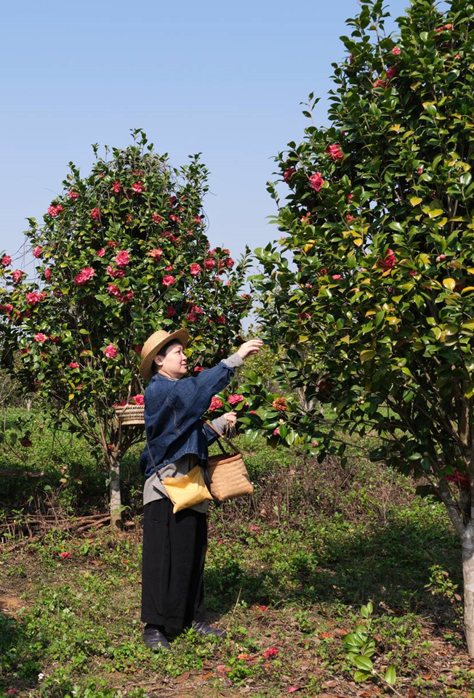
Market overview

Slide 24
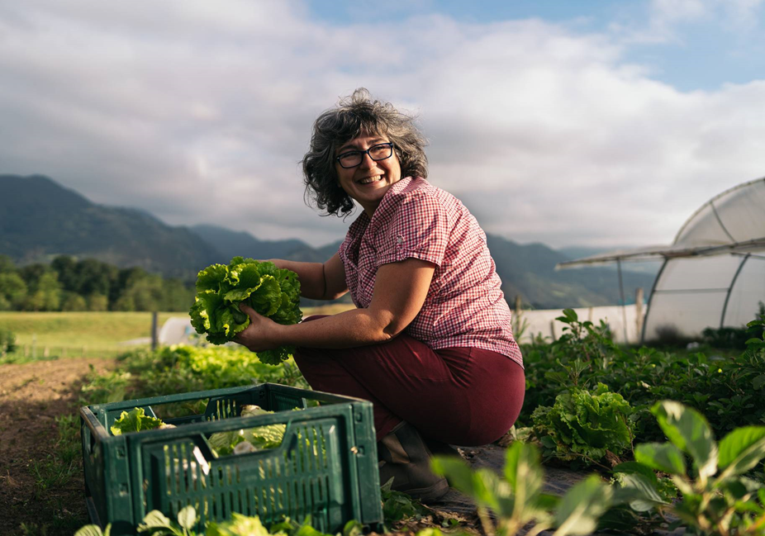
Market comparison
Stands out in market
Innovative features
Provides unique solution
Edge over competitors
User-focused design
Prioritizes user experience

Slide 25
Competitive landscape
Strong market presence
Positioned as a market leader
Leveraging a robust infrastructure
Dedicated team of experts
Outperforming competitors
Good brand name recognition
Need:
More agility and adaptability
Stronger competitive edge
Ability to adapt swiftly
Stay ahead of the curve
Continuously improve offerings
Integrate user feedback

Slide 26
Growth strategy
Expand market reach through strategic partnerships
Enhance product features based on user feedback
Explore international market opportunities
Expand
Foster collaborative growth
Enhance
Ensure a tailored and user-focused experience
Explore
Capitalize on emerging global markets

Slide 27
Traction
Product launch
Successful introduction of our product to market
10,000 user milestone
Substantial user base, indicating growing demand
Strategic partnership
Expanding market presence and capabilities
Milestone | Quarter
Product launch | Q1
10,000 user milestone | Q2
Strategic partnership | Q3
Campaign launch | Q4

Slide 28
Summary
With this product, Best For You Organics is positioned for success in the dynamic market.
With a focus on innovation, user experience, and strategic growth, we anticipate reaching new heights in the coming year.
Our commitment to user satisfaction underscores every aspect of our operations
Strong market positioning
Robust growth strategy
Innovative product development
Commitment to user satisfaction

